Slide 1
INTRODUCTION
Fuzzy matrix theory was first introduced by Michael G. Thomson in 1977 as a branch of fuzzy set theory, which was developed by L.A. Zadeh twelve years prior. They have also introduced the arithmetic mean matrix of an interval valued fuzzy matrix and directly applied Sanchez’s method of medical diagnosis on it.
Fuzzy set theory also plays a vital role in the field of decision making. Decision Making is a most important scientific, Social and economic endeavour. Fuzzy matrices (FMs) are currently very rich modelling issues in Science, automata theory, binary connection logic, medical diagnosis, etc……..
The field of medicine is one of the most fruitful and interesting areas of applications for fuzzy set theory. Sanchez formulated the diagnostic models involving fuzzy matrices representing the medical knowledge between symptoms and diseases. The field of medicine is one of the most fruitful and interesting areas of applications for fuzzy set theory.

Slide 2
Fuzzy set theory has already been used in some medical expert systems. In this paper, we would like to discuss how fuzzy set theory and fuzzy logic can be used for developing knowledge based systems in medicine. Some basic definitions of fuzzy set theory has been discussed in section 2.In section 3,a study approach is presented for medical diagnosis which is also an extension of Sanchez’s approach with modified procedure using triangular fuzzy matrices and its new membership function. Some conclusion are given in section 4.

Slide 3

2. PRELIMINARIES
ARITHMETIC MEAN (TFMF)
Let R = ($R_{1} ,R_{2} ,R_{3})$be a triangular fuzzy number then arithmetic
Mean (R) = $\frac{R_{1}+R_{2}+R_{3}}{3}$.
ADDITION OPERATION ON TFMF
Assume $\overline{R}$ = ($r_{ij}$) and $\overline{S}=(s_{ij}$) be a triangular fuzzy number of same
order matrices . Then $\overline{R} \left(+\right)\overline{S}=\left( r_{ij}+s_{ij}\right)$ where $r_{ij}+s_{ij}$ =$(r_{ijL}+s_{ijU},r_{ijM}+$
$s_{ijL} ,r_{ijU}+s_{ijM})$ is the ${ij}^{th}$ of $\overline{R} (+)\overline{S}$ .

Slide 4
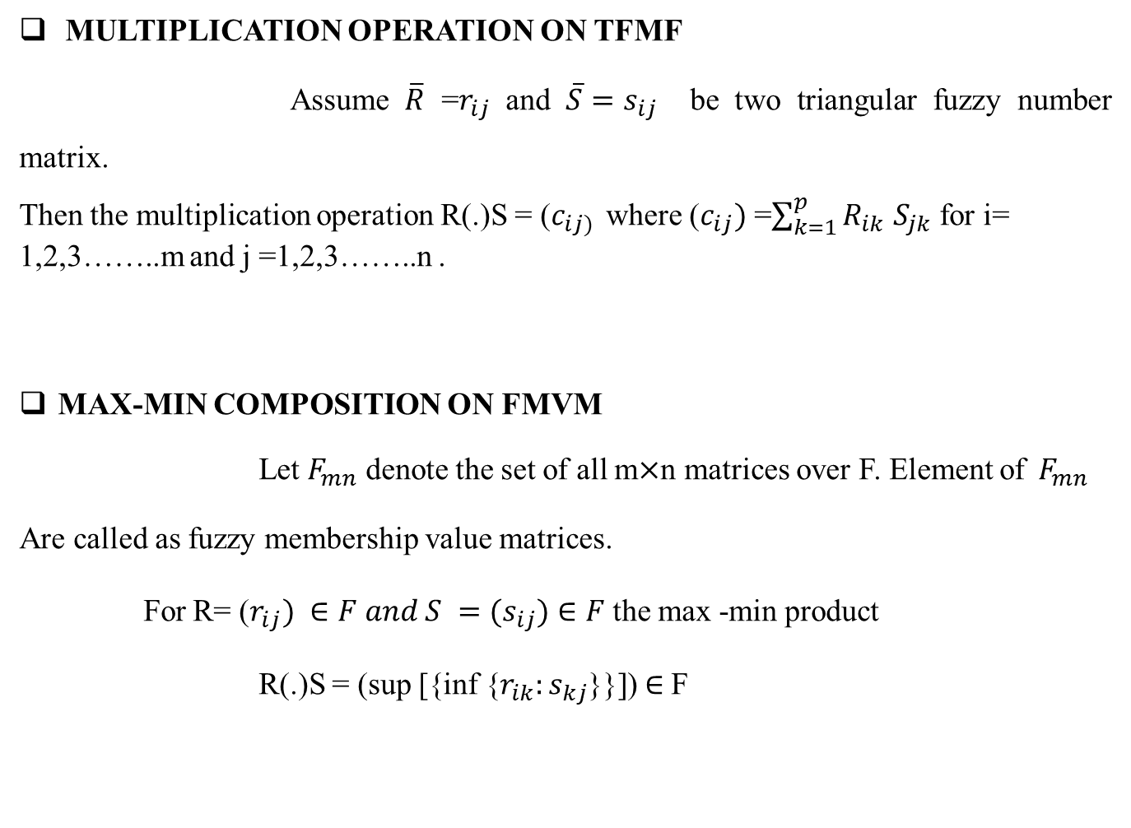
MULTIPLICATION OPERATION ON TFMF
Assume $\overline{R}$ =$r_{ij}$ and $\overline{S}=s_{ij}$ be two triangular fuzzy number matrix.
Then the multiplication operation R(.)S = ($c_{ij) }$ where ($c_{ij})$ =$\sum_{k=1}^{p}{R_{ik}}$ $S_{jk}$ for i= 1,2,3……..m and j =1,2,3……..n .
MAX-MIN COMPOSITION ON FMVM
Let $F_{mn}$ denote the set of all m$×$n matrices over F. Element of${ F}_{mn}$
Are called as fuzzy membership value matrices.
For R= ($r_{ij}) ∈F and S =(s_{ij})∈F$ the max -min product
R(.)S = (sup [{inf {$r_{ik}:s_{kj}$}}])$∈$F

Slide 5
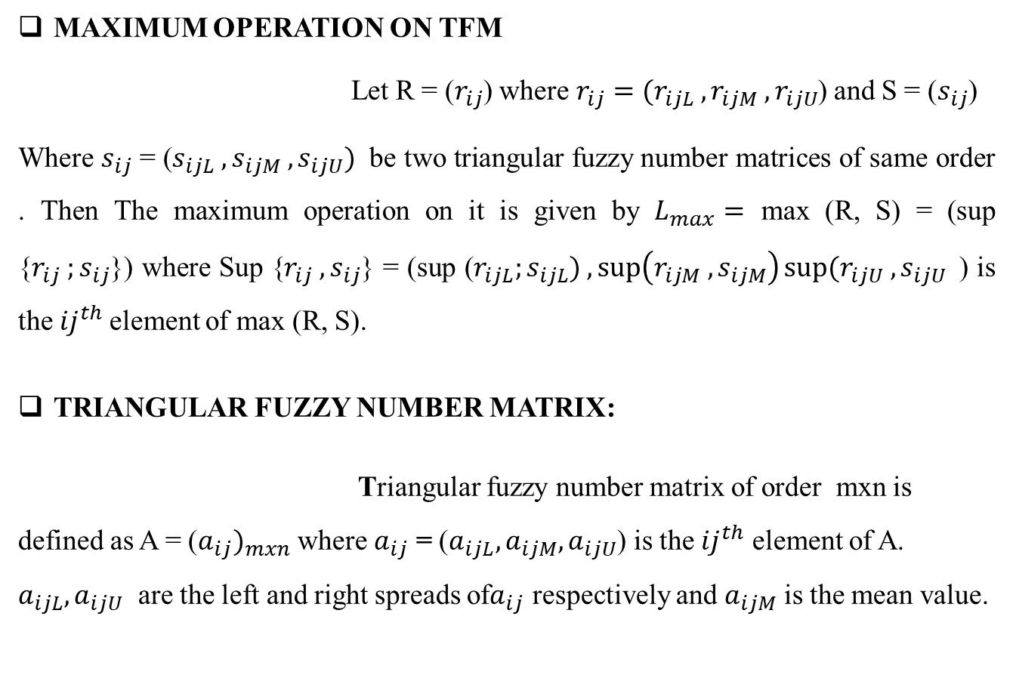
MAXIMUM OPERATION ON TFM
Let R = ($r_{ij}$) where$r_{ij}=(r_{ijL} , r_{ijM} , r_{ijU}$) and S = ($s_{ij}$)
Where $s_{ij}$ = ($s_{ijL} ,s_{ijM} , s_{ijU})$ be two triangular fuzzy number matrices of same order . Then The maximum operation on it is given by $L_{max}=$ max (R, S) = (sup {$r_{ij} ;s_{ij}$}) where Sup {$r_{ij} ,s_{ij}$} = (sup ($r_{ijL};s_{ijL}) ,\sup\left(r_{ijM} ,s_{ijM}\right)sup⁡(r_{ijU} ,s_{ijU }$ ) is the${ij}^{th}$element of max (R, S).
TRIANGULAR FUZZY NUMBER MATRIX:
Triangular fuzzy number matrix of order mxn is defined as A = (${a_{ij})}_{mxn}$ where $a_{ij}$ = ($a_{ijL},a_{ijM},a_{ijU}$) is the ${ij}^{th}$ element of A. $a_{ijL}{,a}_{ijU}$ are the left and right spreads of$a_{ij}$ respectively and $a_{ijM}$ is the mean value.

Slide 6
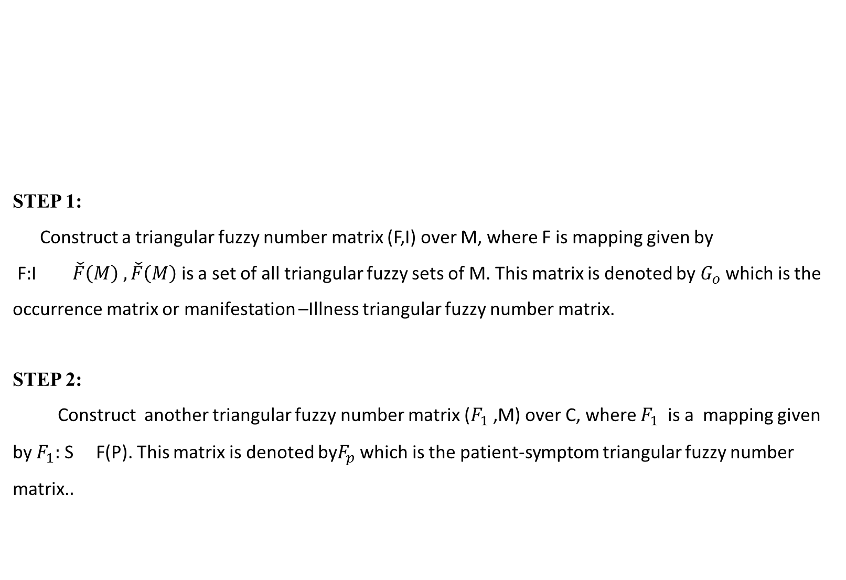
STEP 1:
Construct a triangular fuzzy number matrix (F,I) over M, where F is mapping given by
F:I $\check{F}\left(M\right) ,\check{F}\left(M\right)$ is a set of all triangular fuzzy sets of M. This matrix is denoted by $G_{o}$ which is the occurrence matrix or manifestation –Illness triangular fuzzy number matrix.
STEP 2: Construct another triangular fuzzy number matrix ($F_{1}$ ,M) over C, where $F_{1}$ is a mapping given by $F_{1}:$S F(P). This matrix is denoted by$F_{p}$ which is the patient-symptom triangular fuzzy number matrix.$.$
3.ALGORITHM

Slide 7
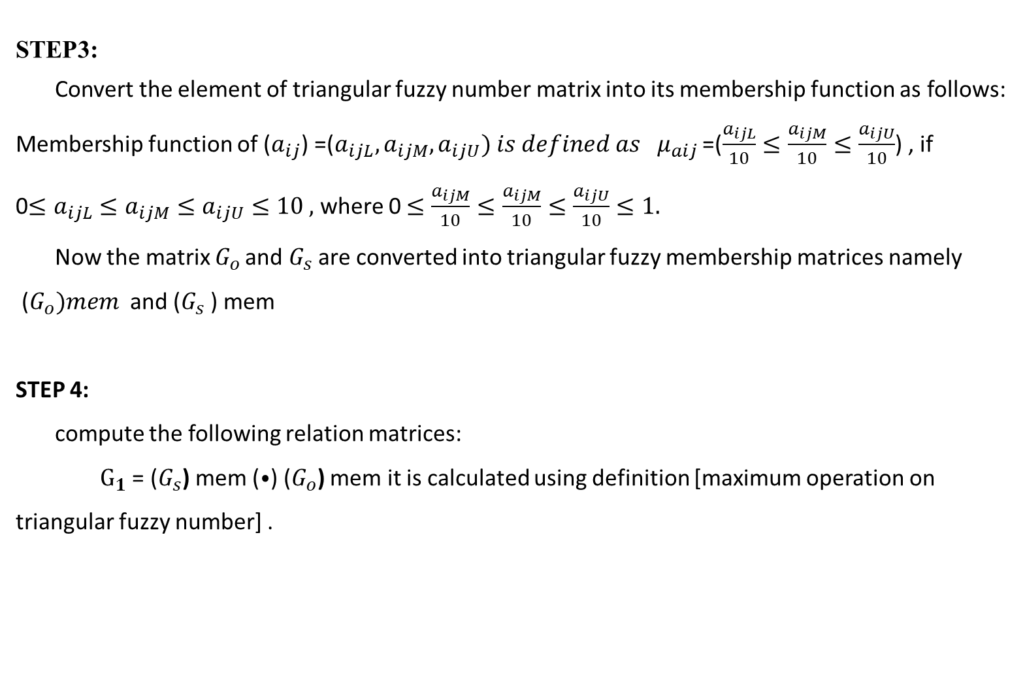
STEP3:
Convert the element of triangular fuzzy number matrix into its membership function as follows:
Membership function of ($a_{ij}$) =($a_{ijL},a_{ijM},a_{ijU}) is defined as μ_{aij}$ =($\frac{a_{ijL}}{10}≤\frac{a_{ijM}}{10}≤\frac{a_{ijU}}{10}$) , if
0$≤a_{ijL}≤a_{ijM}≤a_{ijU}≤10 ,$ where 0 $≤\frac{a_{ijM}}{10}≤\frac{a_{ijM}}{10}≤\frac{a_{ijU}}{10}≤1.$
Now the matrix $G_{o }$and $G_{s}$ are converted into triangular fuzzy membership matrices namely
($G_{o})mem$ and ($G_{s}$ ) mem
STEP 4:
compute the following relation matrices:
$G_{1}$ = ($G_{s}$) mem (⦁) ($G_{o}$) mem it is calculated using definition [maximum operation on triangular fuzzy number] .

Slide 8
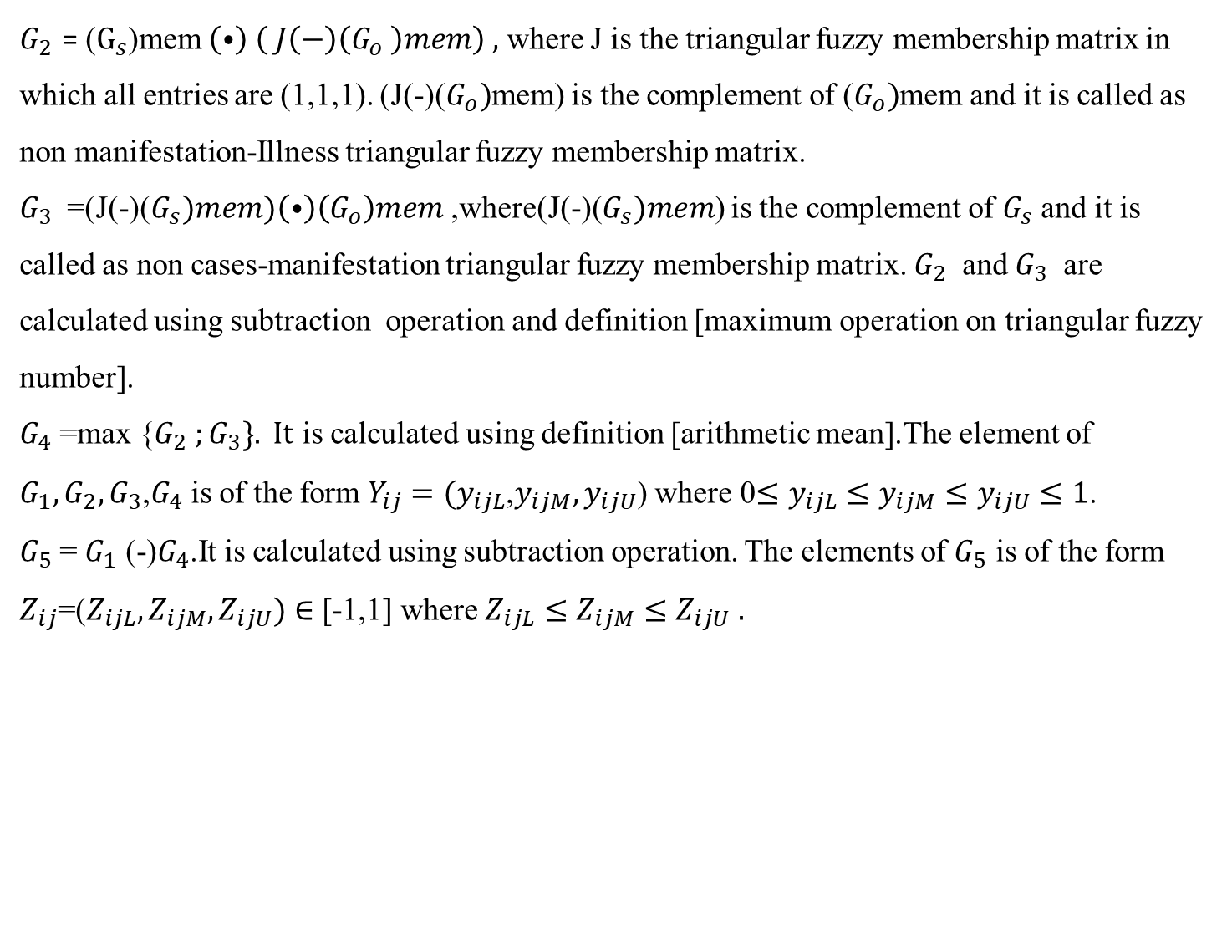
$G_{2}$ = ($G_{s}$)mem $\left(⦁\right) \left( J\left(−\right)\left(G_{o} \right)mem\right) ,$ where J is the triangular fuzzy membership matrix in which all entries are (1,1,1). (J(-)($G_{o})$mem) is the complement of ($G_{o})$mem and it is called as non manifestation-Illness triangular fuzzy membership matrix.
$G_{3}$ =(J(-)($G_{s})mem)\left(⦁\right)\left(G_{o}\right)mem$ ,where(J(-)($G_{s})mem$) is the complement of $G_{s}$ and it is called as non cases-manifestation triangular fuzzy membership matrix. $G_{2}$ and $G_{3}$ are calculated using subtraction operation and definition [maximum operation on triangular fuzzy number].
$G_{4}$ =max {$G_{2} ;G_{3}\}. It$ is calculated using definition [arithmetic mean].The element of $G_{1},G_{2},G_{3}$,$G_{4}$ is of the form $Y_{ij}=(y_{ijL}$,$y_{ijM},y_{ijU}$) where 0$≤y_{ijL}≤y_{ijM}≤y_{ijU}≤1$.
$G_{5}$= $G_{1}$ (-)$G_{4}$.It is calculated using subtraction operation. The elements of $G_{5}$ is of the form $Z_{ij}$=($Z_{ijL},Z_{ijM},Z_{ijU})∈$ [-1,1] where $Z_{ijL}≤Z_{ijM}≤Z_{ijU} .$

Slide 9
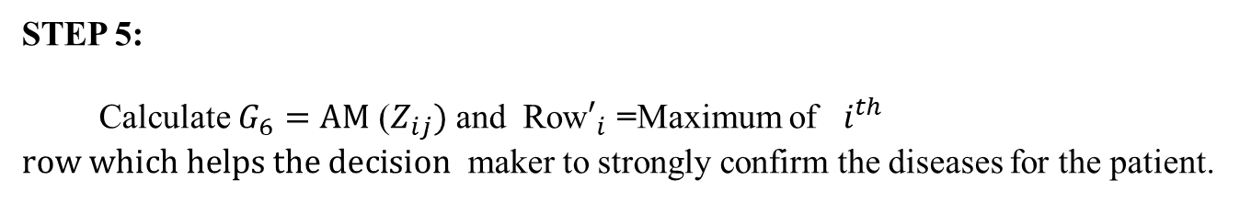
STEP 5:
Calculate $G_{6}=AM$ ($Z_{ij})$ and Row$′_{i}$ =Maximum of $i^{th}$ $row which helps the decision$ maker to strongly confirm the diseases for the patient.

Slide 10

4. CASE STUDY ABOUT DIABETES AND HYPERTENSION CASES BY USING FUZZY MATRIX MODEL
CASE STUDY
Consider three cases $C_{1} ,C_{2} and C_{3}$ admitted in a hospital with Manifestation of Headache, Blurred vision, Chest pain, Lack of energy. Suppose possible Illness with these Manifestation be Diabetes and Hypertension.
We assume that $M_{1} ,M_{2} , M_{3} and{ M}_{4}$ represents the Manifestation Headache, Blurred vision, Chest pain, Lack of energy respectively. Assume that $I_{1} and I_{2}$ represents the Illness Diabetes and Hypertension respectively. Let M =$M_{1} ,M_{2} ,M_{3},M_{4}$ and I = $I_{1} ,I_{2}$ be the parameter set representing the manifestation and Illness respectively. Also let C = $C_{1}$ , $C_{2}, C_{3}$ be the set of cases.

Slide 11
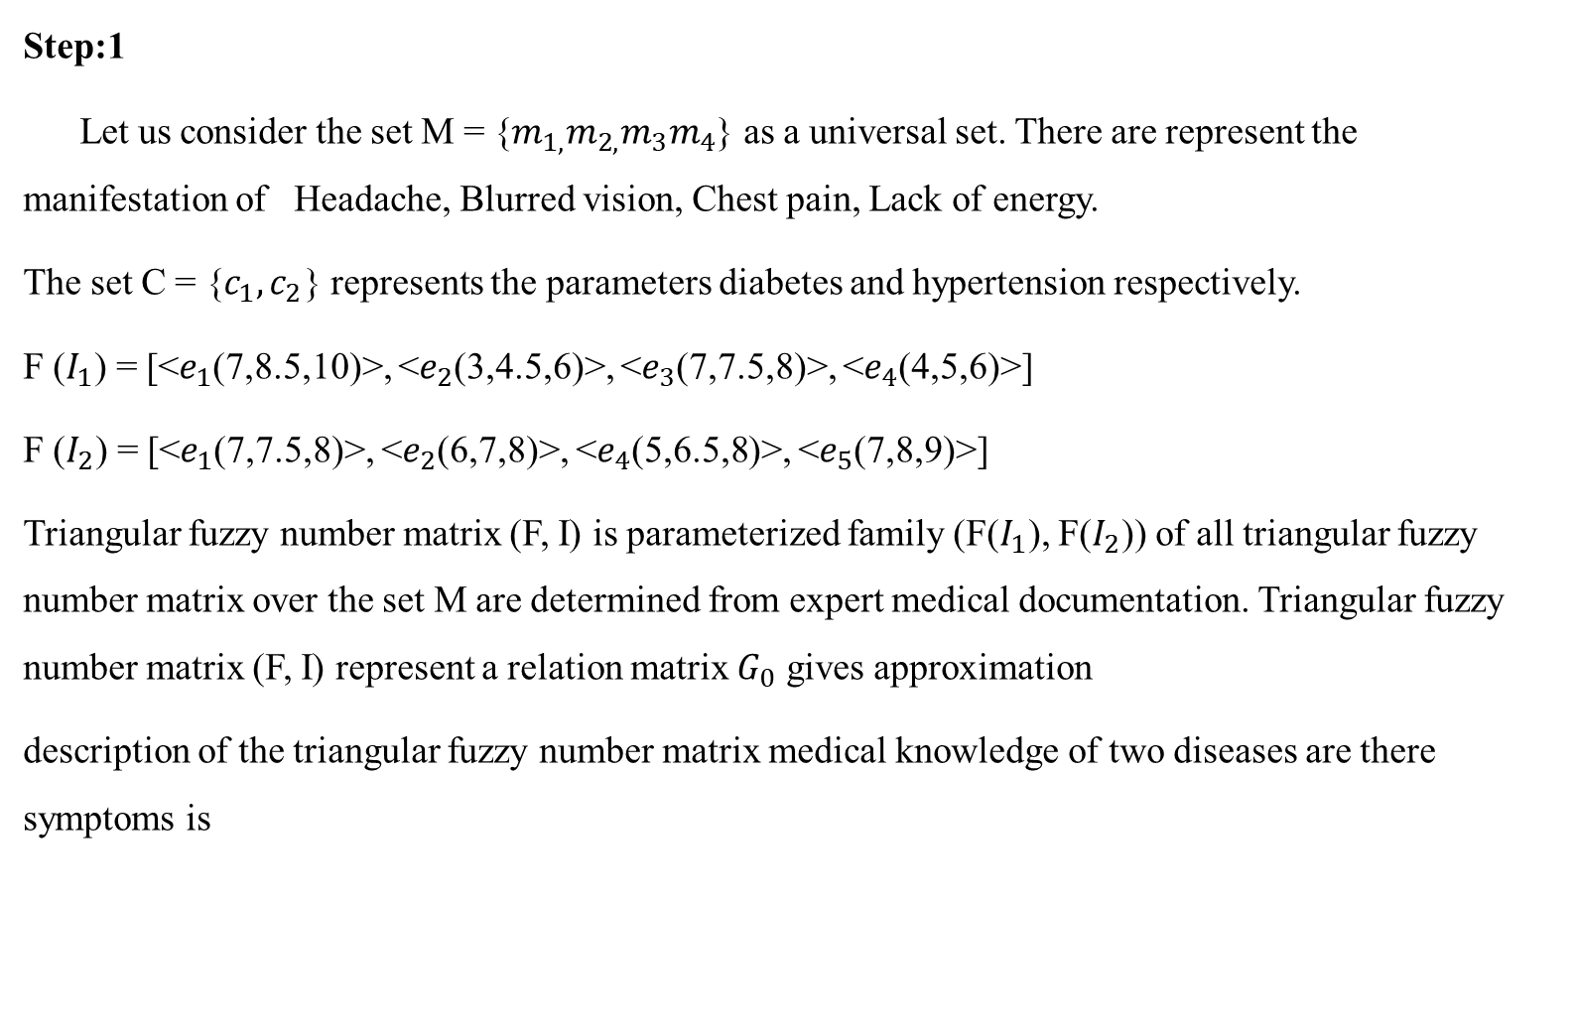
Step:1
Let us consider the set M = {$m_{1,}m_{2,}m_{3}m_{4}$} as a universal set. There are represent the manifestation of Headache, Blurred vision, Chest pain, Lack of energy.
The set C = {$c_{1},c_{2}$} represents the parameters diabetes and hypertension respectively.
F ($I_{1}$) = [<$e_{1}$(7,8.5,10)>, <$e_{2}$(3,4.5,6)>, <$e_{3}$(7,7.5,8)>, <$e_{4}$(4,5,6)>]
F ($I_{2}$) = [<$e_{1}$(7,7.5,8)>, <$e_{2}$(6,7,8)>, <$e_{4}$(5,6.5,8)>, <$e_{5}$(7,8,9)>]
Triangular fuzzy number matrix (F, I) is parameterized family (F($I_{1}$), F($I_{2}$)) of all triangular fuzzy number matrix over the set M are determined from expert medical documentation. Triangular fuzzy number matrix (F, I) represent a relation matrix $G_{0}$ gives approximation
description of the triangular fuzzy number matrix medical knowledge of two diseases are there symptoms is

Slide 12
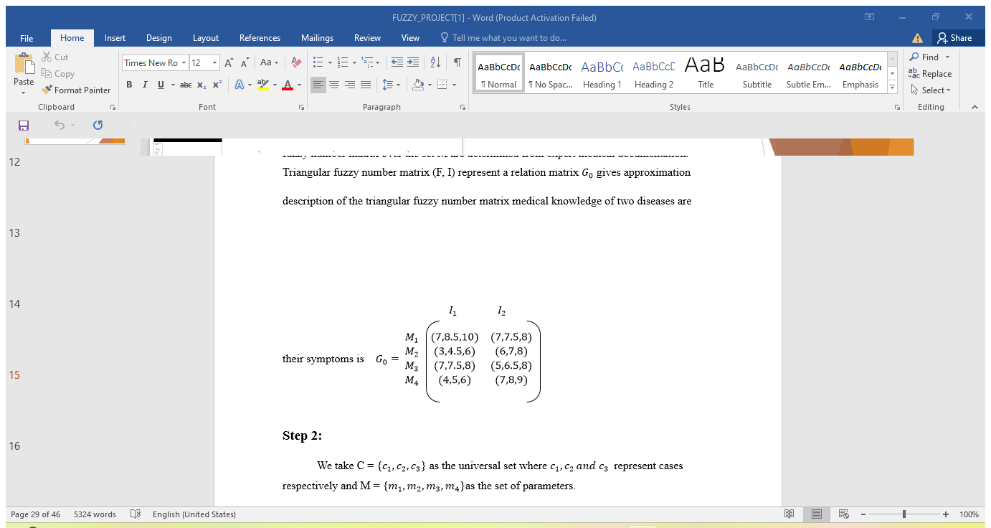
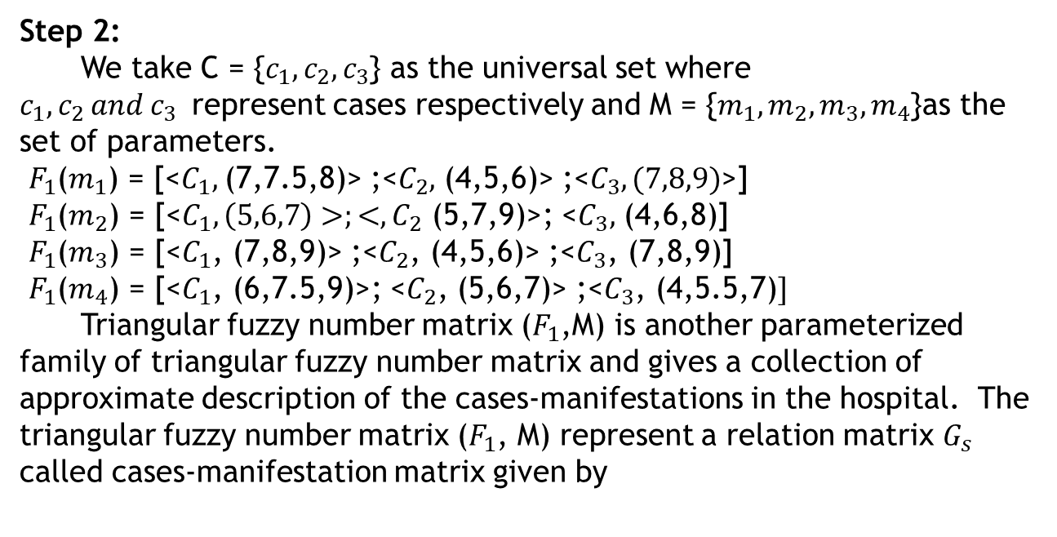
Step 2:
We take C = {$c_{1}, c_{2}, c_{3}$} as the universal set where $c_{1}, c_{2 }and c_{3}$represent cases respectively and M = {$m_{1}, m_{2}, m_{3},m_{4}$}as the set of parameters.
$F_{1}$($m_{1}$) = [<$C_{1},$(7,7.5,8)> ;<$C_{2},$ (4,5,6)> ;<$C_{3}, (7,8,9)$>]
$F_{1}$($m_{2}$) = [<$C_{1}, \left(5,6,7\right)>;<, C_{2}$ (5,7,9)>; <$C_{3},$ (4,6,8)]
$F_{1}$($m_{3}$) = [<$C_{1}$, (7,8,9)> ;<$C_{2}$, (4,5,6)> ;<$C_{3}$, (7,8,9)]
$F_{1}$($m_{4}$) = [<$C_{1}$, (6,7.5,9)>; <$C_{2}$, (5,6,7)> ;<$C_{3}$, (4,5.5,7)$]$
Triangular fuzzy number matrix ($F_{1}$,M) is another parameterized family of triangular fuzzy number matrix and gives a collection of approximate description of the cases-manifestations in the hospital. The triangular fuzzy number matrix ($F_{1}$, M) represent a relation matrix $G_{s}$ called cases-manifestation matrix given by

Slide 13
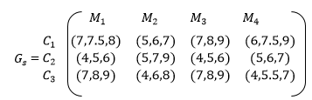
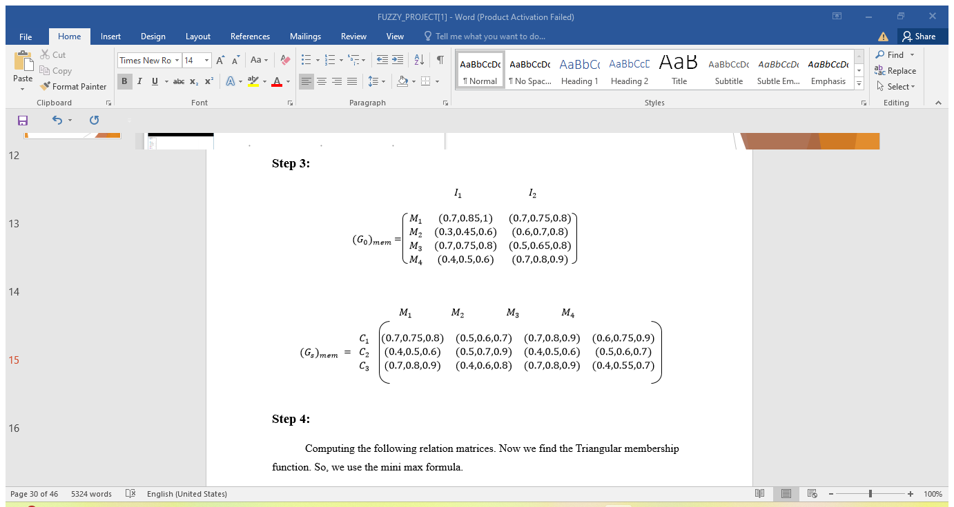

Slide 14
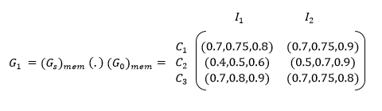
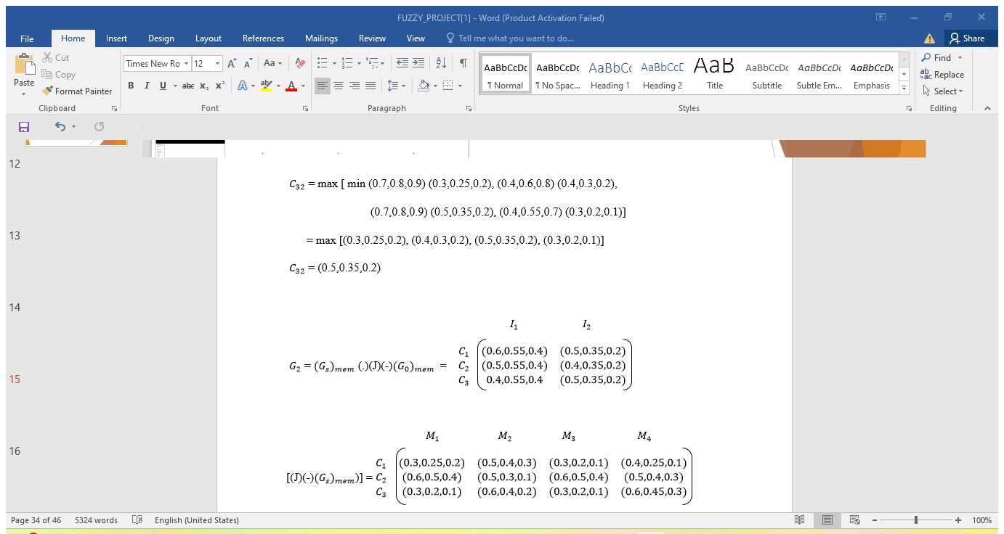
Step 4:
Computing the following relation matrices. Now we find the Triangular membership function. So, we use the mini max formula.

Slide 15
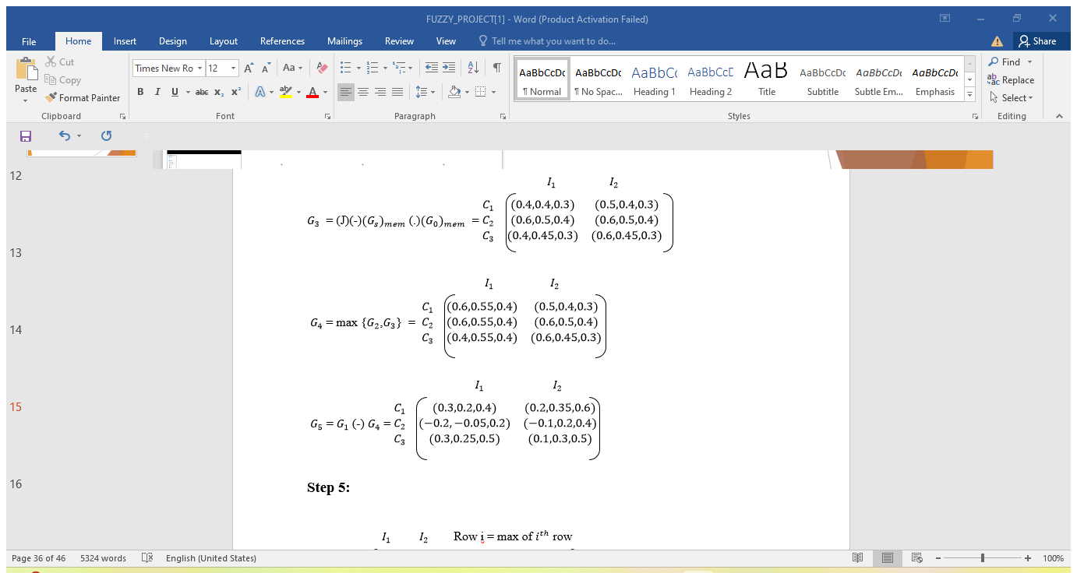

Slide 16
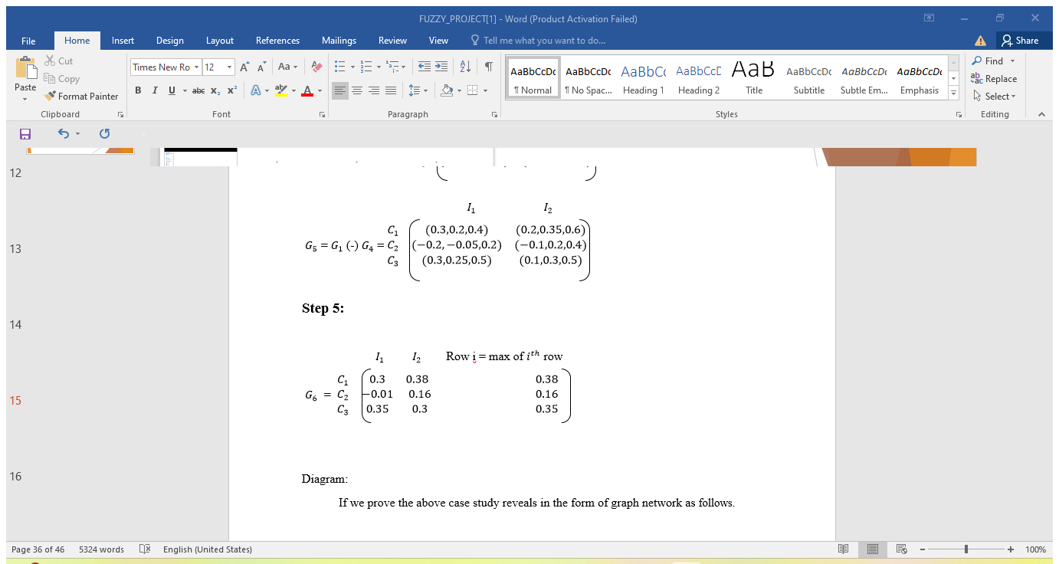
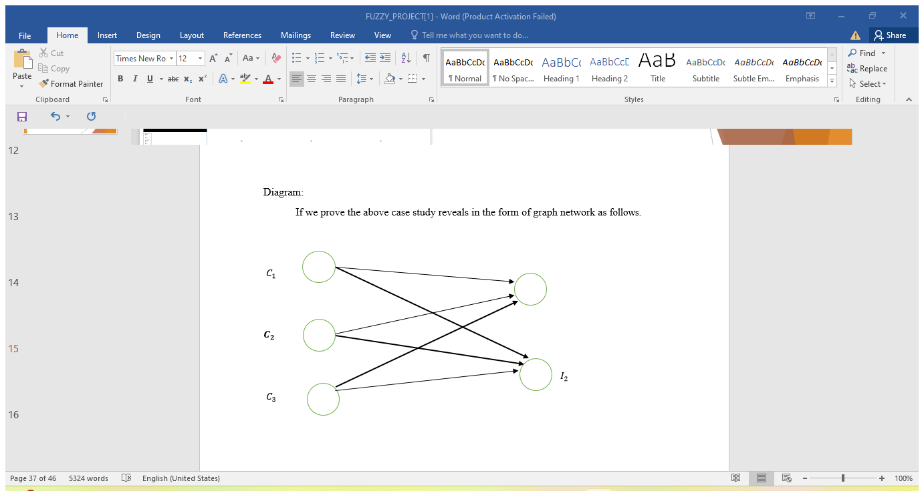

Slide 17
In the above graph network, nodes and vertices denote the cases and illness, lengths and edges denote the assumption of illness to the cases. The darken edges denote the strong confirmation of illness to the cases.

Slide 18
5. APPLICATIONS ON FUZZY SYSTEM IN MEDICAL DIAGONSIS
In the medical field, fuzzy logic is used in the following areas
Medical diagnostic support system
Control of arterial pressure during anesthesia
Multivariable control of anesthesia
Modeling of neuropathological findings in Alzheimer’s patients
Radiology diagnoses
Fuzzy inference diagnoses of diabetes and prostate cancer
Psychology Field:
In psychology, fuzzy logic is used in the following areas
Fuzzy logic based analysis of human behavior
Criminal investigation and prevention based on fuzzy logic reasoning

Slide 19
Fuzzy logic in Medical Field
Fuzzy logic with Asthma Disease:
Asthma is a persistent lung issues influencing lungs because of restricted aviation routes.
It is a sort of hazardous sickness making breathing issues a person.
A framework to determine asthma by allotting boundaries to have fuzzy logic
Fuzzy logic with Diabetes Disease:
It is a kind of sickness coming about high blood glucose level in body
A lot of sugar level in the body leads different issues like harming kidney and nerves.

Slide 20
Fuzzy logic with Cholera Disease:
Cholera is a bacterial disease mostly occurred after consumption of drinking contaminated water.
It is a type of disease that can lead to dehydration, diarrhea and up to death if not tackle at right time.
Fuzzy logic with Breast Cancer:
Breast cancer is a kind of sickness caused because of irregularities found in bosom that shapes the cells.
This infection viewed as the second generally deadliest in ladies when contrasted with cellular breakdown in the lungs.
Fuzzy logic with Liver Disease:
It is a sort of hepatic illness that makes liver forestall working and its working
Most of variables of liver infection are because of alcoholic or hereditary nature.
The most well-known kinds of liver infection are greasy liver.

Slide 21
Fuzzy logic with Dental Disease:
It is a kind of sickness that tainting encompassing teeth as tooth rot, periodontal infection, gum disease, dental plaque
The goal of utilizing fuzzy logic dependent on 164 fuzzy principals as fuzzy extraction with 5 informative factors.
In 2014 proposed a model of consolidating three distinct infections shrouded in one fuzzy master approach.
Fuzzy logic with Heart Disease:
It is a kind of sickness caused because of harm or blockage of veins in heart influencing less supplement and oxygen supply to heart organ.
Various kind of heart illness are normal like vein issue, heart failure, cardiovascular breakdown etc…

Slide 22
Applications of hypertension in medical field:
Data Science Transformation
Precision medicine data revolution
Creation of precision cohorts to decipher heterogeneous treatment effect
Artificial intelligent
Digital Transformation
Enable home blood pressure measurement
Promote healthy behaviors
Population Science Transformation
Cross-sector approach
Health in all policies

Slide 23
Health Care Deliver Transformation:
Better access to diagnosis and effective treatment
Dissemination of standardized evidence based-treatment
Coordinated, team-based care
Bio Medical Transformation:
Novel RNA, DNA cell-based therapies
- RNAi
- Gene editing
- Regenerative medicine

Slide 24
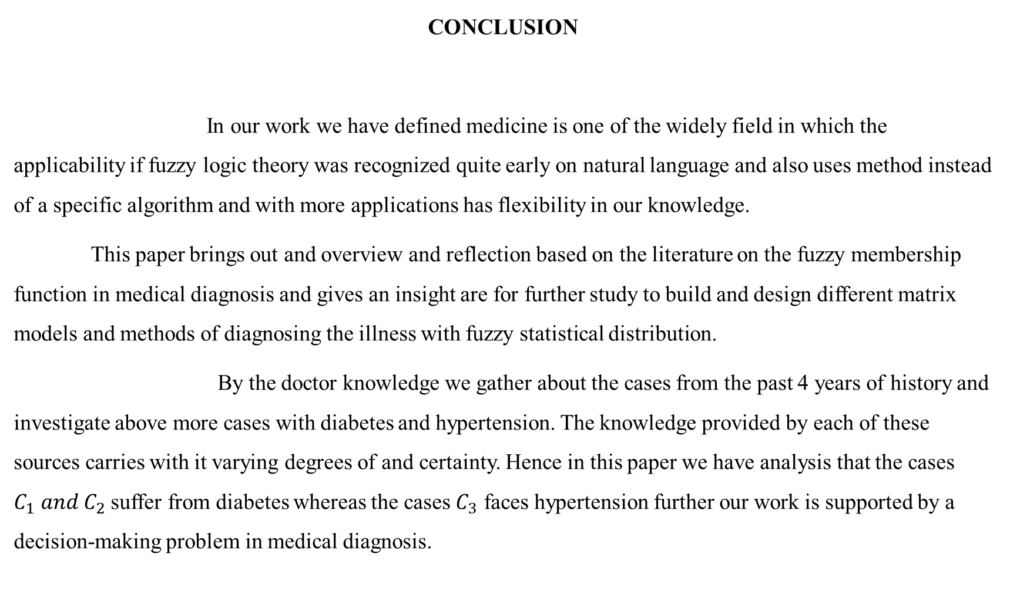
CONCLUSION
In our work we have defined medicine is one of the widely field in which the applicability if fuzzy logic theory was recognized quite early on natural language and also uses method instead of a specific algorithm and with more applications has flexibility in our knowledge.
This paper brings out and overview and reflection based on the literature on the fuzzy membership function in medical diagnosis and gives an insight are for further study to build and design different matrix models and methods of diagnosing the illness with fuzzy statistical distribution.
By the doctor knowledge we gather about the cases from the past 4 years of history and investigate above more cases with diabetes and hypertension. The knowledge provided by each of these sources carries with it varying degrees of and certainty. Hence in this paper we have analysis that the cases $C_{1} and C_{2}$ suffer from diabetes whereas the cases $C_{3}$ faces hypertension further our work is supported by a decision-making problem in medical diagnosis.

Slide 25
References
H. K. Baruah, towards forming a field of fuzzy sets, International Journal of Energy, Information and communications, 2(1) (2011) 16 – 20.
H. K. Baruah, The theory of fuzzy sets: beliefs and realities, International Journal of Energy, Information and Communications, 2(2) (2011) 1 – 22.
R. Bellman and L. A. Zadie, Decision Making in a fuzzy environment, Management Science, 17 (1970) B144-B164.
A. Edward Samuel and M. Balamurugan, Application of intuitionistic fuzzy sets in medical diagnosis, Proceeding of the International Conference on Mathematical Modelling and Applied Soft Computing, 1 (2012) 189-194 .
R. Sophia Porch Elvi, P. Selvavathi and R. Vanitha, An Application of Fuzzy Matrices in Medical Diagnosis.
A.O. Esogbue and R. C. Elder, Fuzzy diagnosis decision models, Fuzzy sets and systems, 3 (1980) 1-9.
A. R. Meenakshi, Fuzzy Matrix theory and applications, MJP publishers, 2008.
A. R. Meenakshi and M. Kalairaja, an application of interval valued fuzzy matrices in medical diagnosis, International Journal of Mathematical Analysis, 5 (36) (2011) 1791-1802.

Slide 26
9. T. J. Neog and D. K. Sut, Theory of fuzzy soft sets from a new perspective, International Journal of Latest Trends in Computing, 2(3) (2011) 439-450.
10.E. Sanchez, Resolution of composite fuzzy relation equations, Information and Control,
30(1976) 38-48.
11. D. Chen, E. C. C., Tsang, D.S. Yeung and X. Wang, The Parameterization reduction of soft sets and its applications, Computers and Mathematics with Applications 49 (2005) 757-763.
12.P. K. Maji and A. R. Roy, soft set Theory, Computers and Mathematics with Applications 45 (2003) 555-562.

Slide 27
THANK YOU

